Slide 1
SUNY Poly Police and Security at SUNY Poly - CNSE
Parking and Security
Rules and Regulations

Slide 2


SUNY Poly Security and UPD
SUNY Poly Security and the SUNY Poly Police Department provide:
  Emergency dispatch and response
  Driving and parking enforcement
  Law and rule enforcement
  Vehicular and foot patrol

Slide 3
SUNY Poly UPD and Security
The Security Control Center is located in the NFE lobby and is staffed 24/7.
The visitor desk in the NFE visitor and Zen desk is staffed by a security officer during business hours.
SUNY Police are contacted through security.
    Dialing 911 from a site landline will ring the Security Control Center.
    Dialing 911 from a cell phone will ring the City of Albany Police Dispatch.
Emergency Number | 518-437-8600
Non Emergency Number | 518-956-7082

Slide 4
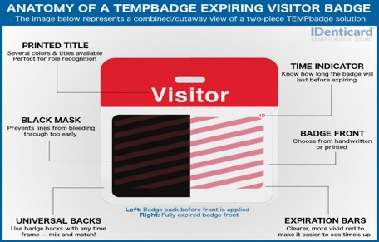
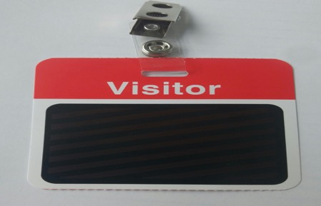
Access Control
Simple Rules to Remember
All badged persons on site must display a SUNY Poly photo identification at all times.
All visitors and new employees who are awaiting identification and safety training processing must have a visitor badge and must be escorted at all times.
If security asks you for your ID you are required to provide it.
Immediately notify security concerning any potential breaches of security or safety.

Slide 5
Access Control
All individuals must receive Safety Orientation prior to receiving an access card/badge.
You will receive an email notifying you that your badge is available to be picked up. Please wait to receive this email prior to coming to the desk requesting your badge.
Badging hours are 9:00 to 12:30 Monday through Friday or by appointment. You must have a valid US drivers license or passport to prove your identity at the time of badge issuance.
To make an appointment, please email Access Control at ACCESSCONTROL@sunypoly.edu
If you have any additional questions or access needs please speak to your supervisor and have them email Access Control.

Slide 6

Access Control
Access to the facility is restricted to individuals with card access clearance.
Do not allow a person to follow you into the building or into interior areas requiring proximity card access (tailgating).
Do not prop doors.
Do not allow use of your access card or ID badge by any other person.
Do not borrow another person’s access card.
Anyone found using an access card belonging to someone else will cause both persons access to be shut off pending investigation.

Slide 7

Access Control
  Only admit persons with valid identification badges into buildings and your work areas.
  Direct persons without badges to security.
  Enter and exit through designated doors only.
  Do not defeat locks or latches.
  Do not leave unsecured doors unattended.

Slide 8
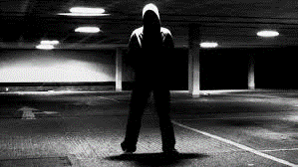
What to Report
Recording or monitoring activities, taking pictures.
Attempts to gain information about operations.
Obtaining badges, access cards, credentials, etc.
Attempts to enter restricted areas.
Suspicious persons that are out of place. This may include people who are in places they should not be, as well as people who do not fit into the daily routine.
Suspicious packages, bags, or mail.
Broken doors, locks, windows, and inoperative lights.

Slide 9

How to Report
Report suspicious activity and potential breaches to personal safety or security immediately by contacting site Security at 518-437-8600.
When reporting
  Identify yourself by first and last name.
  Provide your location and be specific as possible.
  WHO, WHAT, WHEN, WHERE, WHY and HOW.
  Remain on the line until the Security Officer retrieves all necessary information.

Slide 10
Assist Security
Safety and security is everyone’s responsibility…
Know Routines.
Be aware of what is going on around you.
Take what you hear seriously.
Monitor and control who is entering your workspace.
Check identifications.

Slide 11
Lost Access Cards/Keys
Lost access cards/keys should be immediately reported to security. Security will deactivate lost access cards and request replacement of door cores/keys.
PLEASE NOTE THAT THERE IS A $20.00 FEE TO REPLACE LOST SUNY POLY ACCESS CARDS.
If you left your access card and/or ID at Home?
  You will have to report to one of the security visitor desks for a visitor badge. Access cards are unique to each individual. Security will not produce an access or identification card for individuals who left them at home.

Slide 12
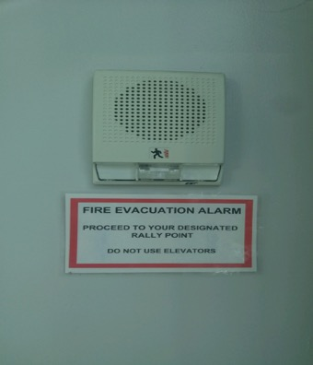
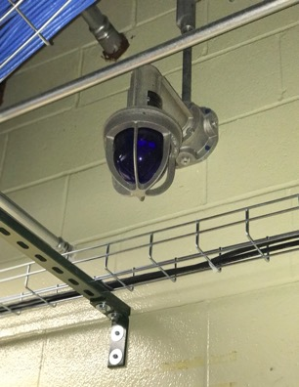
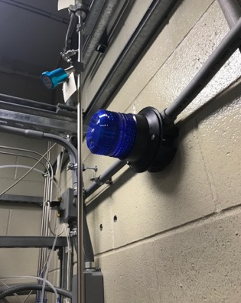
Roof Policy
Notify Security before accessing any site building rooftop.
Report to the Security Desk and sign the Roof Logbook.
You must have a cell phone in your possession, so security can call you in the event of an emergency.

Slide 13

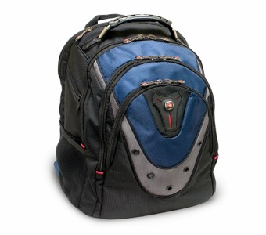
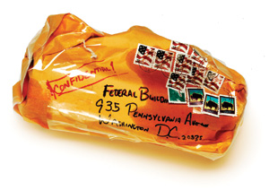
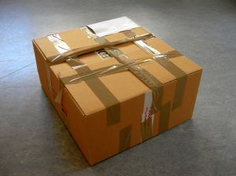
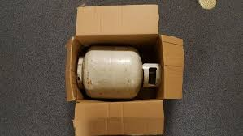
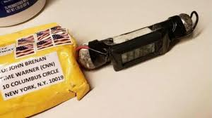
Suspicious Packages/Bags
What makes it a suspicious package/bag?
Is it out of place?
Excessive tape or string
Rigid or bulky
Lopsided or uneven
Protruding wires or metal
Strange odor
Wrong title with name
Oily stains, discolorations, or crystallization on wrapper

Slide 14
Suspicious Packages / Bags
If you think it is suspicious…
Immediately call security.
Do not shake, move, or empty the contents.
Do not open, smell, or touch the package.
Do not have others examine the package.
Isolate the area by closing doors or sectioning off the area to prevent others from entering.
Wash your hands with soap and water as soon as possible.

Slide 15

Telephone Threats
Remain calm.
Remain on the line. DO NOT HANG UP. Let the other person hang up on you.
Write down the threat verbatim.
Pay attention to background. Noises, music, cars, etc.
Listen closely to the voice. Note any accents, gender, lisp, slurs, etc.
Immediately notify security.

Slide 16
Practice Personal Safety
Make use of the “buddy system”. Walk with a friend.
Take advantage of the 24/7 personal safety escort program provided by security. Call or stop by the security desk in the NFE rotunda.
Park your vehicle under a light if you are expecting to be on-site after dark. Have your keys ready for accessing your vehicle or building.
Enter and exit via the NFE rotunda, the security control centers location if you are working after hours or on weekends.
Program your cell phone with the security phone number…..518-437-8600.

Slide 17
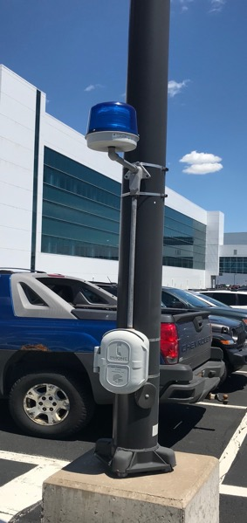
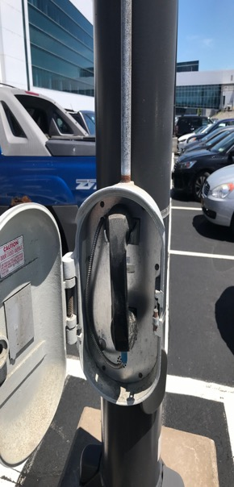
Emergency Phones
“Blue light” emergency phones are located throughout the parking areas.
These phones are directly connected
to the Security Control Center. Security
will make whatever notifications are
necessary.
Telephones are located throughout
and on the exteriors of each building on
site. You must dial 518-437-8600 or 911
to speak with security.

Slide 18
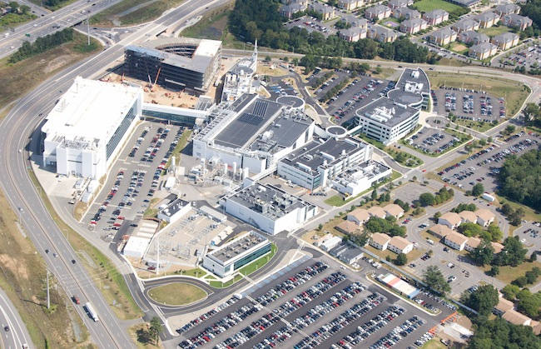
Parking Policy Overview

Slide 19

Parking Policy Overview
Parking is by SUNY Poly permit only.
Vehicles must possess valid state registrations and inspections.
All roadways on the site are fire lanes.
If there is no sign and no lines it means “NO PARKING”. Do not block emergency lanes, loading zones, fire hydrants, sidewalks, travel lanes, etc.
All vehicles must be parked in areas that are designated for parking.
Any vehicle violating the above rules or creating a hazard will be subject to immediate tow at YOUR expense without warning.

Slide 20
Parking Policy Overview
DO NOT PARK in a reserved parking space that is not yours. Violators are subject to immediate tow without notice.
If you need to bring a temporary vehicle to the site, move your parking permit to the temporary vehicle each day you bring it.
Hosts are responsible for advising visitors concerning parking rules and regulations.
Over-night parking is allowed when approved in advance by security.
  You may pick up and complete the form at the security control center in the NFE.

Slide 21
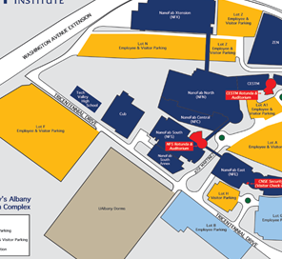
Parking Policy Overview
General parking is available in Lots A, F
and N
There is no parking allowed in Freedom Quad.
  This lot is monitored by UAlbany. If you park in this lot, you may be ticketed and/or towed at your expense.

Slide 22

Pedestrian Safety
Take Steps to Avoid Injury While Walking:
Be visible and make eye contact with drivers of vehicles.
Never assume a driver will give you the right of way or stop.
Stay alert, head up, and avoid distractions such as cell phones or other electronic devices while walking.
Walk in safe places even though it may not be the quickest or most direct path. Use crosswalks when crossing the streets.
Look left, right, and left again before crossing a street.
Stand clear of parked cars or other obstacles before crossing so drivers can see you.

Slide 23

Driver Safety on Site
Driving Safety Tips
CNSE Site Speed Limit is 15 MPH.
Focus 100% of your attention on driving.
Don’t use your phone or any other electronic device while driving.
Observe and Obey all traffic signs (e.g., stop, yield, pedestrian crossing, crosswalk, speed limit) to ensure the safety of yourself and others.
Yield for pedestrians at all times and in crosswalks.
Always wear your seat belt.
Drive safely and defensively on site roads, in parking lots, etc.
SUNY Poly Police patrol and monitor campus wide and enforce all NYS motor vehicle laws.

Slide 24
Workplace Violence
Every year, approximately two million people throughout the country are victims of non-fatal violence at the workplace. Officials at the Department of Justice have found violence to be a leading cause of fatal injuries at work with about 1,000 workplace homicides each year.

Slide 25
Workplace Violence
Level One (Early Warning Signs)
The person is:
intimidating/bullying;
discourteous/disrespectful;
uncooperative; and/or
verbally abusive.
Response When Early Warning Signs Occur at Level One
Observe the behavior in question.
Report concerns to your supervisor to seek help in assessing/responding to the situation. If the offending employee is the reporting employee's immediate supervisor, the employee should notify the next level of supervision. If the offending person is not an employee, the supervisor of the employee reporting the incident is still the appropriate individual to receive and provide initial response.
Document the observed behavior in question.

Slide 26
Workplace Violence
Level Two (Escalation of the Situation)
The person:
argues with customers, vendors, co-workers, and management;
refuses to obey agency policies and procedures;
sabotages equipment and steals property for revenge;
verbalizes wishes to hurt co-workers and/or management;
sends threatening note(s) to co-worker(s) and/or management; and/or
sees self as victimized by management (me against them).
Response When the Situation Has Escalated to Level Two
If warranted, Call 911 and/or security, particularly if the situation requires immediate medical and/or law enforcement personnel.
Immediately Contact the supervisor.
If necessary, Secure your own safety and the safety of others, including contacting people who are in danger.
Document the observed behavior in question.

Slide 27
Workplace Violence
Level Three (Further Escalation – Usually Resulting in an
Emergency Response)
The person displays intense anger resulting in:
suicidal threats;
physical fights;
destruction of property;
display of extreme rage; and/or
utilization of weapons to harm others.
Response When Situation is a Level Three Emergency
Any individual observing violent or threatening behavior which poses an immediate danger to persons or property is expected to:
Call 911 and/or security particularly if the situation requires immediate medical and/or law enforcement personnel.
Remain Calm and Contact supervisor.
Secure your personal safety first.
Leave the area if your safety is at risk.
Cooperate with law enforcement personnel when they have responded to the situation.

Slide 28
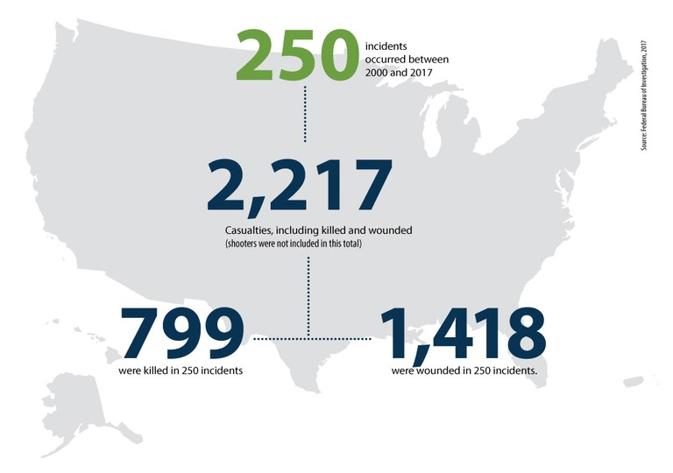
Active Shooter

Slide 29
Active Shooter
Active Shooter Options for Consideration
Video
Copy and past the link to view the video.
https://www.dhs.gov/xlibrary/videos/17_0728_NPPD_active-shooter-awareness.mp4

Slide 30
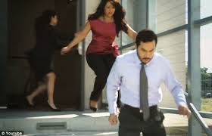
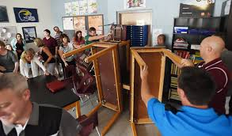
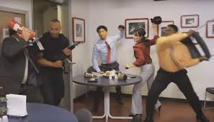
Active Shooter
Remember…
Run
            2. Hide
3. Fight

Slide 31
Active Shooter
Best Practices
Be aware of your environment and any possible dangers.
Take note of the nearest exits.
If you are in an office and are unable to run, secure and/or barricade the door and remain quiet.
If you are unable to run or hide fight using any and all means to win.
If a police officer approaches you keep your hands visible and follow their commands.
CALL 911 WHEN IT IS SAFE TO DO SO.

Slide 32
Questions?
518-956-7082
or
Visit us in the NFE Rotunda

Slide 33
IT Familiarization Module
Purpose: Basic understanding of what resources are available on the SUNY Poly Internet/Intranet page and clean room restrictions regarding PCs and removable media

Slide 34
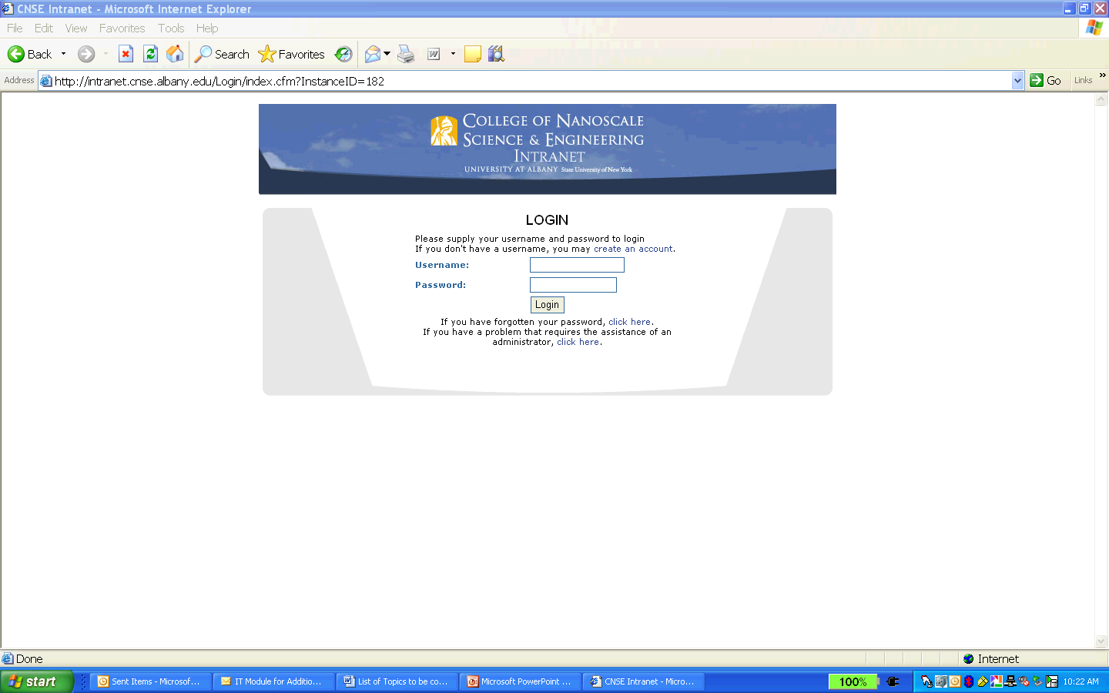
SUNY Poly Intranet http://intranet.sunycnse.com
New accounts
Password Resets

Slide 35

Important Points to Remember
Company owned laptops can be brought into the clean rooms provided their operating system patching and anti-virus software are up-to-date and the device and any removable computer storage media is scanned for viruses on a regular basis.
All removable media (flash drives, hard drives, CDs) must be scanned at the scanning station outside the gowning room before entering and after exiting the cleanroom.
Personally owned laptops, phones, iPods, etc. are not allowed to be connected to cleanroom wifi due to concerns for network security, data confidentiality, and malware infections.

Slide 36
Important Points to Remember
The SUNY Poly Help Desk is available to assist you with IT related issues.
The Help Desk can be reached by telephone at 518-956-7272 and by email at cnsehelp@sunypoly.edu
- 24/7 Coverage
Thank you for your attention.
- Questions?

Slide 37
SUNY Poly EH&S
Training
WELCOME
BASIC SAFETY
ORIENTATION
INCLUDING
HAZARD COMMUNICATION TRAINING
(HAZCOM)
and
Initial Hazardous Waste Training

Slide 38

Course Objectives
Increase your awareness of Environmental, Health and Safety (EHS)
Inform you of your responsibilities and how you can promote EHS
Review SUNY Polytechnic Institute (SUNY Poly) EHS policies and requirements
Tools and resources for:
  recognizing
  controlling hazards
Notes:
Emphasize that not all information is covered in detail.
It is important that the employees supervisor and or manager do a follow-up with the needed details and or specifics related to the job and tasks at hand.

Slide 39
SUNY Poly EHS Policy Statement
SUNY Poly is committed to:
Protecting the health and safety of its employees, partners, customers and public
Protecting the environment
Complying with regulatory standards
Notes:
Emphasize that not all information is covered in detail.
It is important that the employees supervisor and or manager do a follow-up with the needed details and or specifics related to the job and tasks at hand.

Slide 40
Employee Responsibilities
All individuals are responsible for safety at SUNY Poly
Take an active role in your safety and the safety of others
Plan for and perform tasks in a safe manner
Follow SUNY Poly and your own company’s safety policies and procedures
Understand the potential hazards you may be exposed to
Contact your manager if you feel you need additional safety training
Notes:
Take the time to understand and educate yourself in area hazards and tasks.
Responsibility should not just be limited to oneself but to assist and communicate to others if there are hazards and concerns in the area.
Instructors Notes
Objective: All employees need to work together to achieve this objective

Slide 41
Employee Responsibilities
Contractors must comply with the SUNY Poly Contractor Safety Guide (Access the Guide from the SUNY Poly website)
Be alert for maintenance concerns and report any concerns with the SUNY Poly facility (e.g., restrooms, air conditioning, walkways, stairs, doors, lighting, parking lots) to cnsefix@sunypoly.edu for corrective action
Take action to correct potential hazards in the workplace by notifying your manager
Notes:
Take the time to understand and educate yourself in area hazards and tasks.
Responsibility should not just be limited to oneself but to assist and communicate to others if there are hazards and concerns in the area.
Instructors Notes
Objective: All employees need to work together to achieve this objective

Slide 42

Additional EHS Training
CLEANROOM SAFETY TRAINING:
  For employees who go in the cleanrooms at SUNY Poly.
LABORATORY SAFETY TRAINING:
  For SUNY Poly students or employees who work in laboratories.
  Please ask your supervisor what additional training you may need.
  Cleanroom and/or Laboratory Safety are required prior to access being granted for any cleanroom or lab.
  Both classes are available online

Slide 43
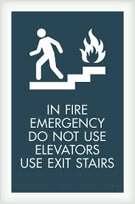


Site Emergencies and Reporting

Slide 44





Site Emergencies
The following emergencies can occur at this facility:
  Fire/Smoke
  Laboratory/Gas Alarm
  Chemical Spill
  Medical
  Utility Failure
  Violence or Terrorism
For any emergencies at the SUNY Poly facility you must contact SECURITY IMMEDIATELY (518) 437-8600
For emergencies at the:
  University at Albany SUNY Campus call 911 from a land line
  SUNY Poly PV Halfmoon Facility call 911
Notes:
Communicate that there is a difference in Site Emergency protocols from CNSE and SUNY Campus.
More importantly the contact emergency number–
Store the number in your cell phone “ICE” for quick easy access in case of an emergency.

Slide 45
Emergency Response Team “ERT”
ERT is comprised of a team of trained employees
  (8 Full-Time ERT Technicians and ~60 volunteers)
The team’s purpose is to evaluate on-site emergencies 24/7 and take appropriate actions
  ERT’s are 1st responders for our site who are trained in First Aid and CPR
  For any evacuations do not go back into the area until the ‘all clear’ is given by ERT/EHS
For ERT assistance or reporting an emergency, contact Security at 518-437-8600

Slide 46

Gas Alarm Procedures
(does not apply to UAlbany Labs)
Automatically activated by SUNY Poly’s Toxic Gas Monitoring System (TGMS)
ERT is paged immediately
Audible and visual alarm
Cleanrooms and subfabs shall evacuate via the nearest exit (gowned)
Regroup in:
  NFS rotunda if in NFS or NFSX
  CESTM rotunda if in NFN, NFC, NFX or CESTM
Alarm and warning set points based on ACGIH TLV’s
INTERMITTENT
TONE
BLUE FLASHING LIGHT
Inside the Building
Notes:
Repeat the information to ensure understanding of the Gas Alarm protocol ( exit to Rotunda) versus the Fire ( exit outdoors)

Slide 47

Fire Emergency Alarms
Evacuation Alarm – All Buildings
ZEN (Building 201) Only
  Evacuation Alarm on Incident floor, one floor up and one floor down
  Alert on all other floors (no flashing lights)
Intermittent Tone
White Flashing Light
Voice Enunciation
Evacuation
Alert ZEN Only

Slide 48
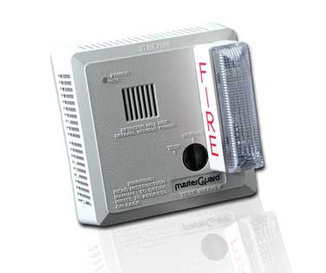
Fire Emergency Procedures
Fire/Smoke
If you see fire/smoke (and building is not in alarm)
- Leave the fire area, assist others that are in danger area
- Close the door to the room/area where the fire is located
- Activate fire pull station, normally located at door to stairwell
- Contact Security at (518) 437-8600 from a safe location
- Continue exiting the building, report to your rally point
If you hear the fire alarm
- Evacuate via the nearest building exit
- Report to your rally point
- If able assist others while
evacuating
Do NOT use the elevators
Notes:
Repeat exit protocols for Gas and Fire

Slide 49
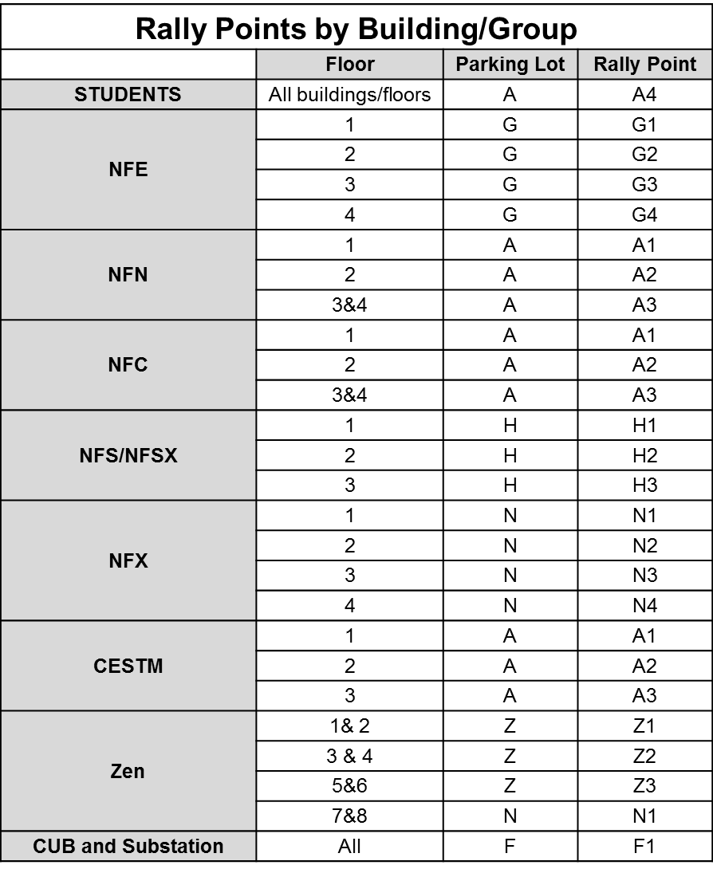
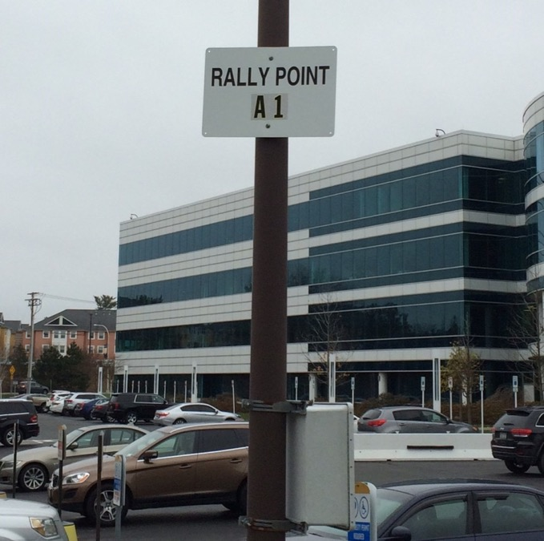
Rally Points are Located at Designated Light Poles in the Parking Lots

Slide 50
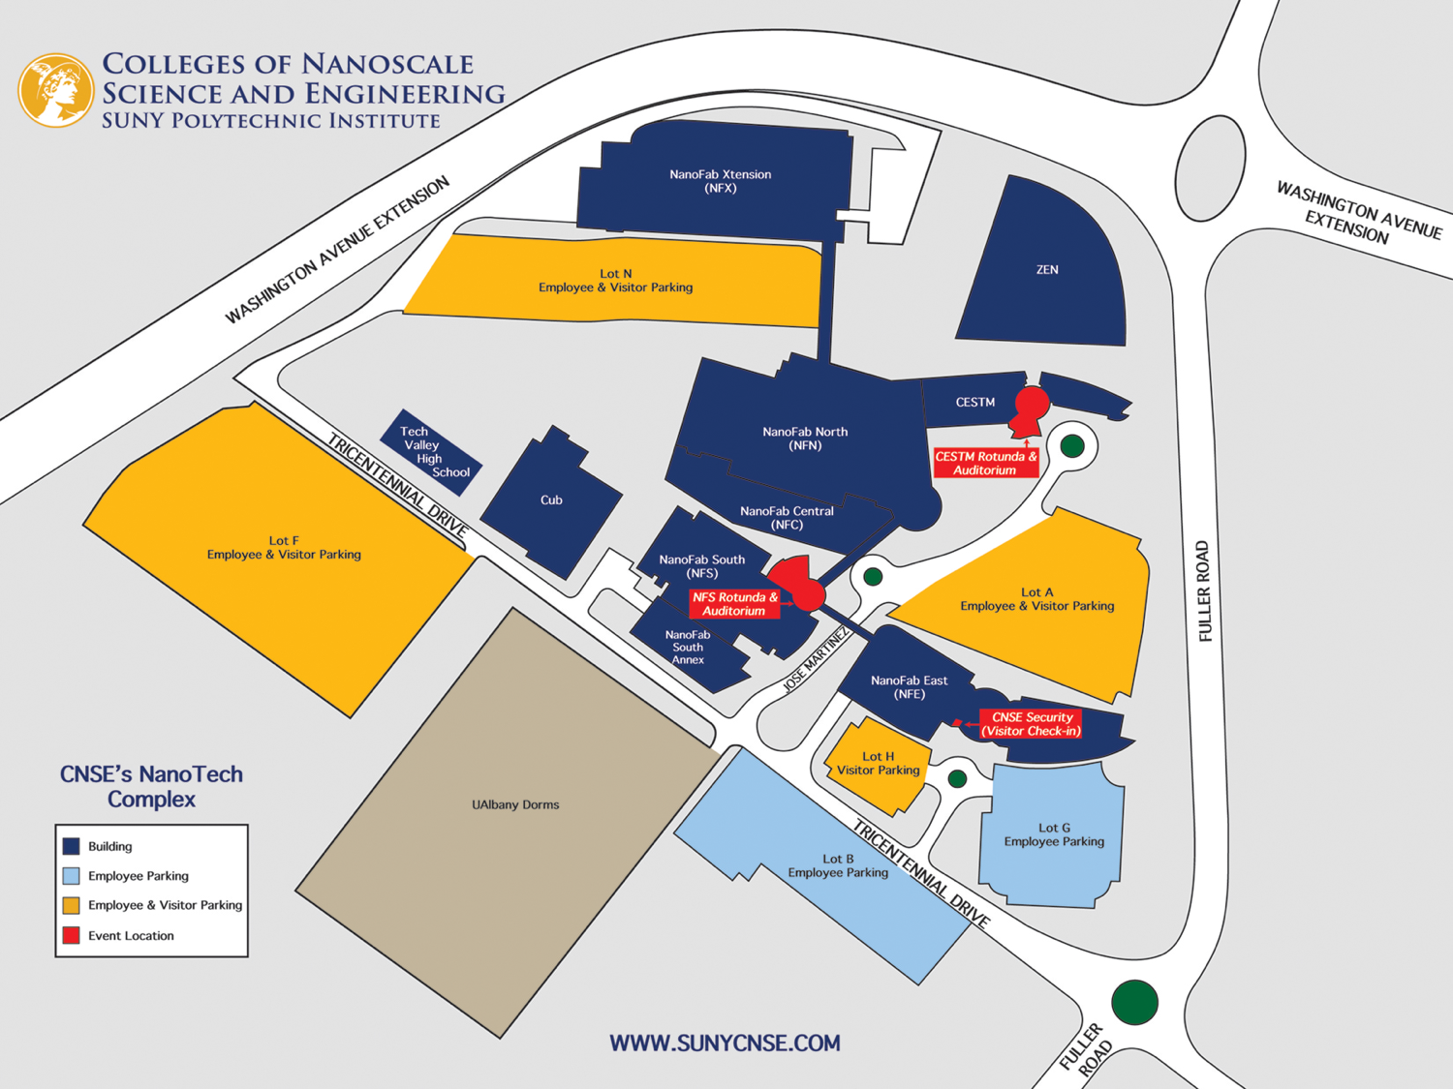
N4
N3
N2
N1
Z3
Lot z
Z2
Z1
F2
F1
A3
A2
A1
A4
For Emergency Evacuations – Know Your Rally Point Location
Map & Example of Rally Points
 | Floor | Rally Point
STUDENTS | All buildings/floors | A4
CESTM | 1 | A1
 | 2 | A2
 | 3 | A3
H3
H2
H1
G4
G3
G2
G1

Slide 51


Emergency Reporting
REPORT any work related injury, accident, illness, fire, medical emergency or chemical spill to security at 518-437-8600 and to your manager
Managers with EHS assistance will:
  Investigate work related incidents (e.g., injury, accident)
  Complete an incident report
  Take corrective action(s) to prevent recurrence
Notes:
Do not delay- reporting means just that – report it– and incident or injury at first may not seem significant or serious at first – but just reporting will help in getting understanding and information if it does escalate or if similar trends exist.

Slide 52
Hazard Communication For Chemicals
SDS
Labeling Requirements
Handling, Storage and Disposal

Slide 53
Safety Data Sheets (SDS)
  Source of information on hazards of chemicals
  SDSs (formerly MSDS) are available 24/7 using the HAZMIN database on the EHS intranet page (Approved Chemical List).
EHS approves all chemical purchases on a lab by lab or tool by tool basis.
All Chemicals must have an SDS on file
Notes:
If needed go through the basic sections of the msds and why it is important to be familiar with this document.

Slide 54
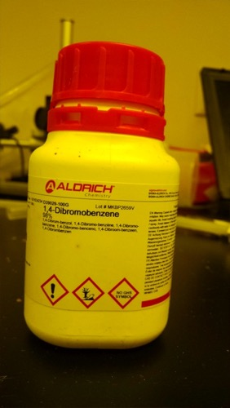
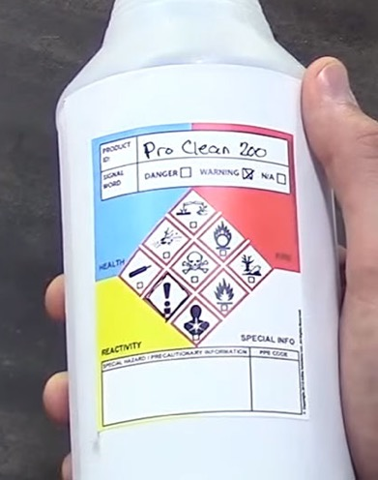
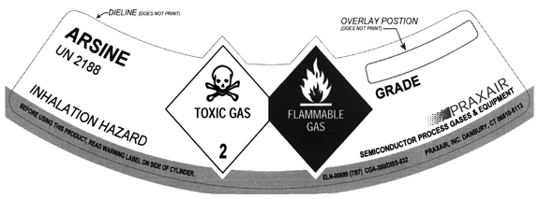
Chemical Labeling
All chemical containers must be labeled properly!
  Name of Chemical
  Primary Hazard(s)
  Pictograms
Notes:
Discuss the need to ensure proper labeling on all containers

Slide 55
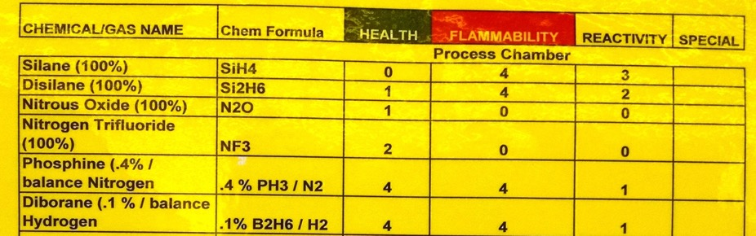

Labels – NFPA Diamond (External)
National Fire Protection Association
Flammability –
Flash Points:
4 – Below 73 ºF
3 – Below 100ºF
2 – Between 100ºF and 200ºF
1 – Above 200ºF
0 – Will not burn
Health Hazard
4 – Deadly
3 – Serious or Permanent injury
2 – Temp. Incapacitation
1 – Significant irritation
0 – No Hazard
Instability:
4 – May self detonate
3 – Shock and heat may detonate
2 – Violent chemical change
1 – Unstable if heated
0 – Stable
Special Hazards: OX – oxidizer ACID – Acid ALK – Alkali
W – reacts violently w/water COR – Corrosive SA – Simple Asphyxiants

Slide 56
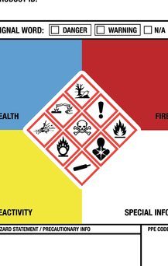
GHS Workplace Labeling
Pictograms – diamonds indicating chemical hazards
Signal Word- either “Danger” or “Warning” as identified on the chemical SDS. Signal Word is determined by hazard category.
Hazard Statements- describe the nature and degree of the product risks
Precautionary Statements- how to handle the product in order to minimize risk

Slide 57






GHS Pictograms
Flammables (Flame) Chemicals capable of igniting Includes: Pyrophorics, self reactives, organic peroxides
Oxidizers (Flame over circle) Initiate or promote combustion
Explosives (Exploding Bomb) Includes: Explosives, Self-reactives, Organic Peroxide
Corrosive Destructive to tissues and/or metal Includes: Acids, bases, peroxides
Gas Cylinder Includes: Gas under pressure
Environmental Hazard Environmental Toxicity

Slide 58



GHS Pictograms
 | Exclamation Mark Category 4 Acute Toxicity Includes: Irritants, Dermal Sensitizers, Narcotic Effects, Resp. Tract Irritants
 | Health Hazard Includes: Carcinogens, Respiratory Sensitizers, Mutagenicity and Target Organ, Reproductive and Aspiration Toxicity
 | Skull and Crossbones Includes: Acute Toxicity

Slide 59
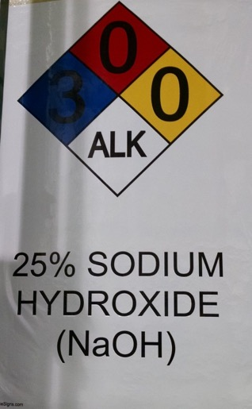



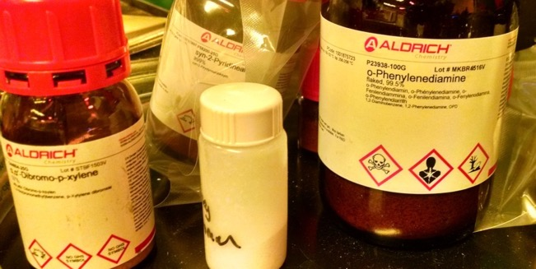
Types of Chemicals at SUNY Poly
Flammables and Pyrophorics
Carcinogens
Toxics
Corrosives
Oxidizers
Compressed Gases
Cryogenics

Slide 60
How Can You be Exposed?
How Can You be Exposed?
Ingestion: Eating
Inhalation: Breathing in through the mouth or nose
Injection: Needle stick or into a cut, directly into bloodstream
Absorption: Contact with the skin or eye
Notes:
Ask the class if they have seen or know of instances of the above.

Slide 61

Prevent Exposure Using the Hierarchy of Controls
Engineering Controls
Administrative Controls
Personal Protective Equipment (PPE)
  NOTE: Hard hats are required in the NFN/NFC subfab
Notes:
Communicate the importance of knowing what PPE is needed for the task.
Review the MSDS for basic PPE information
Ask your supervisor and or a CNSE EHS representative if you are unsure of what is needed.

Slide 62

Chemical Exposure
If you suspect that you have been exposed to a chemical and are experiencing any of the following symptoms:
  Dizziness
  Shortness of breath
  Headache
  Upset stomach
  CALL (518) 437-8600
  and
  CONTACT YOUR SUPERVISOR IMMEDIATELY
Notes:
To protect yourself from unexpected injury from a hazardous chemical, refer to the MSDS for that chemical.
It will list the signs and symptoms of chemical toxicity for both local and systemic reactions as well as the target organs and primary routes of entry.
Always use personal protective equipment and follow safety guidelines appropriate for the chemical.
And avoid relying on your memory or tips from co-workers:
Review the MSDS whenever you have the slightest doubt about the hazards
of any chemical.

Slide 63

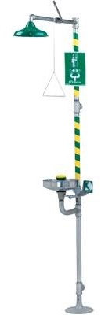
If you are splashed with a chemical
Go to the closest shower
  Remove contaminated clothing: Clothing will keep the chemical in close contact with the skin
  Rinse for 15 minutes with water or until medical help arrives
  Get someone to call (518) 437-8600 and notify your supervisor
  Contact to the eyes: Hold eyelids open and apart with your thumbs and finger while rinsing
Notes:
Modesty can be a concern – please re-enforce the importance to help others out in case of an emergency if it can be done without harm to you. Assist were needed.

Slide 64
Waste Labeling

Slide 65

Universal Waste
Batteries
Ballasts
Lightbulbs
- When you need to dispose of universal waste, use the appropriate universal waste label and bring to a dedicated satellite accumulation area

Slide 66
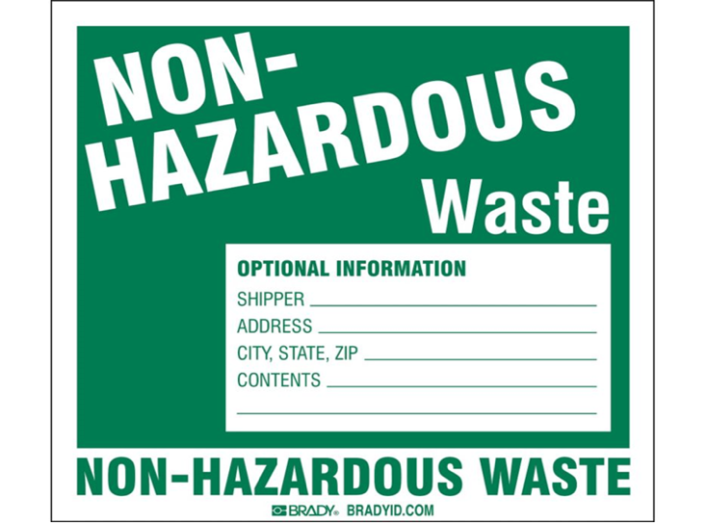
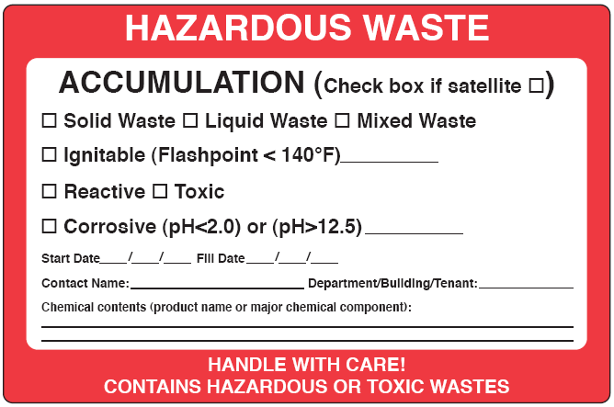
Chemical Waste
Do not put ANY chemicals down the drain or in the trash
Waste goes in Satellite Accumulation Areas
Broken glass needs to be placed in a hard-walled container before disposal
Broken wafers go in the wafer disposal bins

Slide 67
General Safety

Slide 68




ACCIDENT PREVENTION SIGNS
Danger signs: Indicate immediate danger and that special precautions are necessary
Caution signs: Indicate a possible hazard against which proper precautions should be taken
Safety instruction signs: indicate general instructions on safety measures
Notes:
Instructors Notes
Begin with Video … Re-enforce message!
? What was the message
? What is Hi Voltage? …
Review OSHA Regs on QEW!
? Who has been shocked

Slide 69
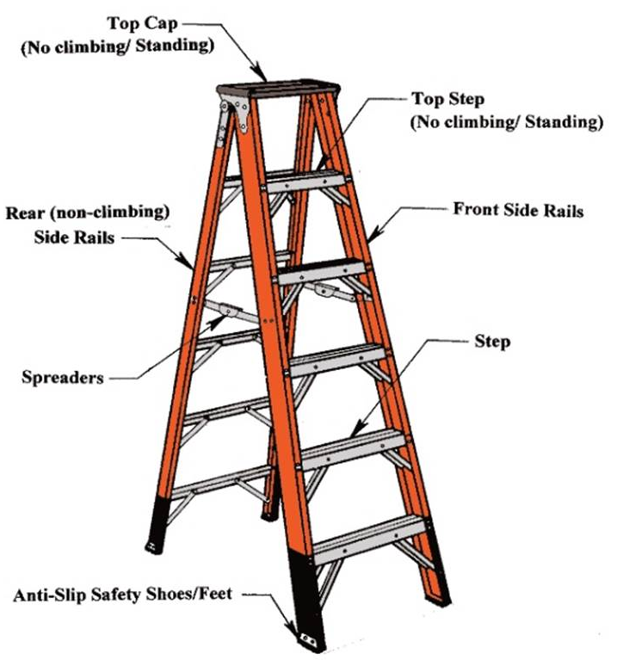





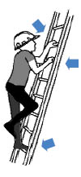

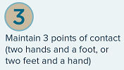
Ladder Safety

Slide 70


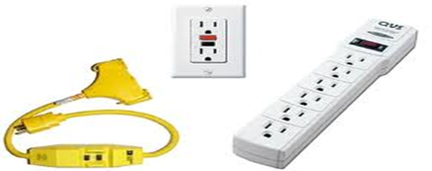
Electrical Safety
Only authorized, qualified and trained personnel are allowed to work on electrical equipment, circuits and parts
Do not:
  Overload electrical outlets
  Use damaged electrical cords (worn/frayed insulation or exposed wires)
  Daisy chain (plug an outlet strip into an outlet strip, etc.)
  Use extension cords in place of permanent wiring.
Do:
  Inspect wiring, power cords, and electrical tools before use for damage to cords
  Use GFCI in areas with water
  Use extension cords with a GFCI for temporary or portable equipment
  Report any electrical shocks
Notes:
Emphasize to not daisy chain electrical cords- do they know what a daisy chain is.
Are area electrical cords in good condition?
Instructors Notes
Begin with Video … Re-enforce message!
? What was the message
? What is Hi Voltage? …
Review OSHA Regs on QEW!
? Who has been shocked

Slide 71
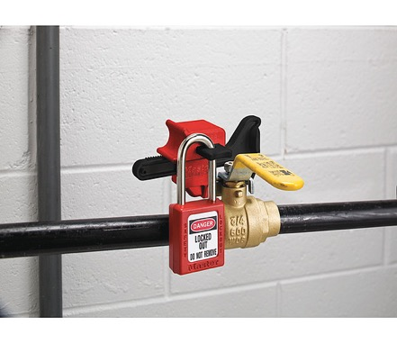
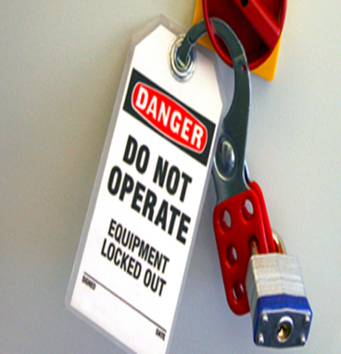
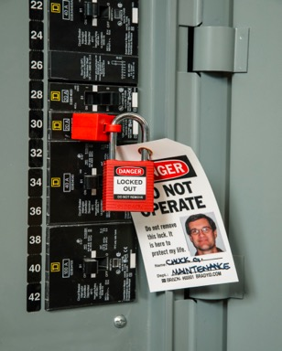
Control of Hazardous Energy (Lockout/Tagout ) (LOTO)
Used to safeguard employees from the unexpected startup of machinery and equipment or the release of hazardous energy during service or maintenance activities
Employees must be authorized and trained to do LOTO and perform maintenance of equipment
Do Not defeat, tamper with, ignore, or operate any devices, or start up any machines or equipment that is locked or tagged out
The tags and locks shall only be removed by the authorized person who attached them
Notes:
Specifies action and procedures necessary to safeguard employees from the unexpected startup of machinery and equipment or the release of hazardous energy during service or maintenance activities
Emphasize to not daisy chain electrical cords- do they know what a daisy chain is.
Are area electrical cords in good condition?
Instructors Notes
Begin with Video … Re-enforce message!
? What was the message
? What is Hi Voltage? …
Review OSHA Regs on QEW!
? Who has been shocked

Slide 72


Housekeeping
Ensure emergency exits, aisles, fire extinguishers, safety showers and eye-wash fountains are unobstructed
All doors (e.g. exit, stairwell) must be working properly (door hardware and latching devices operating correctly)
Keep storage at least 18 inches below fire sprinkler heads
Keep drawers and doors of desks, cabinets, etc., closed when they are not being used
Be sure that emergency exit signs are readily visible, and the illuminated type emergency exits signs are in fact lit
Demonstrate positive housekeeping and cleanliness of our facility, by keeping work areas clean and organized
Take corrective action when appropriate!
Notes:
Review the above items

Slide 73

Working Alone (EHS-00045)
Work Alone policy is broken down into two areas:
  Tasks that can be performed alone (e.g., office type work)
  Tasks that need to be done with a buddy
You can not work alone on site (e.g., cleanroom, lab or facilities areas) while performing hazardous activities - you must have a buddy at all times
  Buddy can be someone that is in constant attendance, working in the area, within sight and sound
Notes:
Communicate that it is important to know and be able to account for all personnel if an incident occurs.
Plan and communicate if you will work alone.

Slide 74
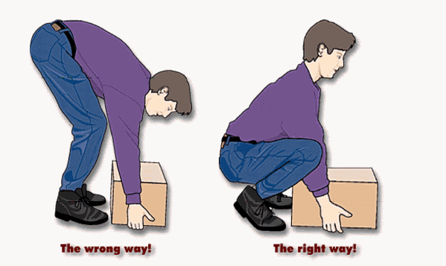

Ergonomics/Safe Lifting
    The safe lifting zone is between the knees and shoulders, bend at the knees not the waist, keep the load close to the body, use both hands and DO NOT Twist
    Push items rather than pull them
  Perform an ergonomic assessment of your work station/area
Notes:
Re-iterate the need to evaluate the task or job for proper handling and set-up.
All tasks and jobs may not have the option for the ideal set-up – what other steps can be taken to avoid injury/strains
- Extra breaks, stretching etc..

Slide 75
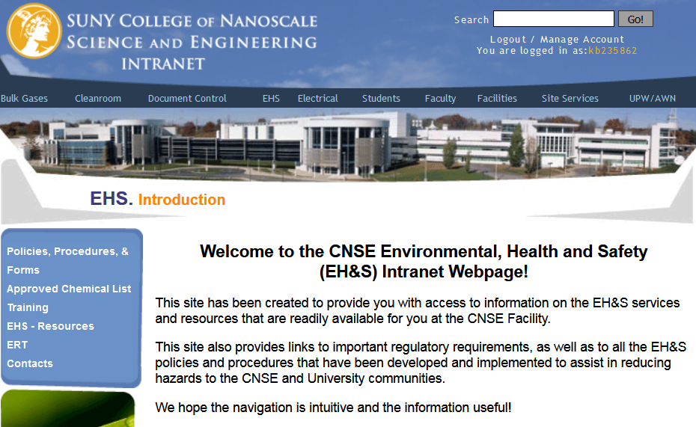
EHS Intranet Homepage
Permits, Training,
Policies & Procedures, Ergonomics
Notes:
Take the time to login and review the EHS information provided

Slide 76
Internet
Go to sunypoly.edu
In the top right click on search
Search EHS
Click on the link for contractor training.
https://sunypoly.edu/research/albany-nanotech-complex/contractor-training.html

Slide 77
Closing
SUNY Poly is committed to providing you a safe working environment
You are a key player in this effort
All individuals onsite are expected to share that commitment
Each of us must comply with safety and environmental laws and SUNY Poly safety requirements
Thank you in advance for your support and efforts toward workplace safety and health

Slide 78
SUNY Poly Quality
Policy

Slide 79

Quality Policy

